Slide 1
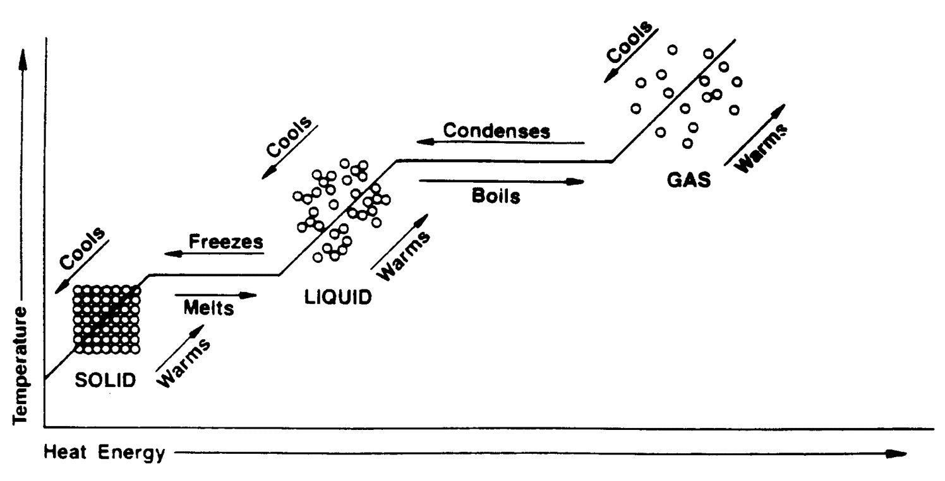
Calculating heat changes through phase changes
Givens (for water):
Cp_{solid} = 2.1 J/g°C
Cp_{liquid} = 4.18 J/g°C
Cp_{vapor} = 1.7 J/g°C
∆H_{fus} = 6.01 KJ/mole
∆H_{vap} = 40.7 KJ/mole

Slide 2
How much heat is released when 45.0g of water cools from 80.0˚C to 25.0˚C?

Slide 3
How much heat is released when 45.0g of water cools from 80.0˚C to 25.0˚C?

Slide 4
How much heat is required to heat 25.0g of ice (solid water) from -20.0˚C to 35.0˚C?

Slide 5
How much heat is required to heat 25.0g of ice (solid water) from -20.0˚C to 35.0˚C?

